Slide 1
⏤⏤rise of robo-advisors
Fintech homework1
Weiqing Wang
9/5/2019

Slide 2
Overview and Origin: Wealthfront
founded by Andy Rachleff and Dan Carroll in 2008.
finished series G funding in 2018, raising $75 million
$11 billion asset under management as of Jan 2019
Andy: saw a need to democratize access to sophisticated investment products
Dan: it’s clear that most people don’t have access to good financial advice

Slide 3
Business Activities
Problem:
financial advice is expensive to get and most of people don't have access to good financial products
Cutomers:
millenials who are accustomed to managing their daily lives through their smartphones
Technology:
Uses Artificial Intelligenece (AI) to empower the automated investment advisor

Slide 4


Slide 5
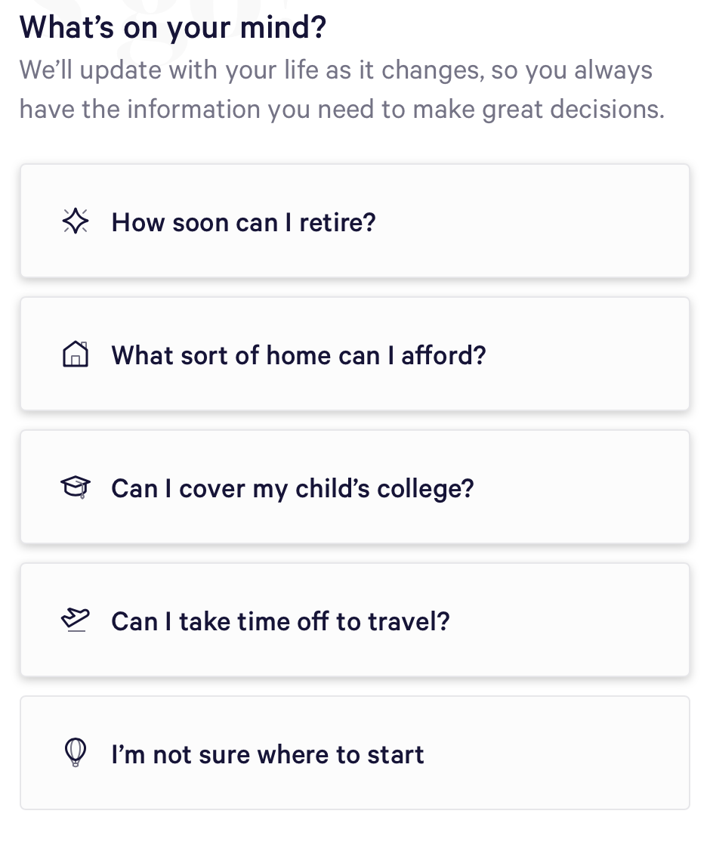

Slide 6
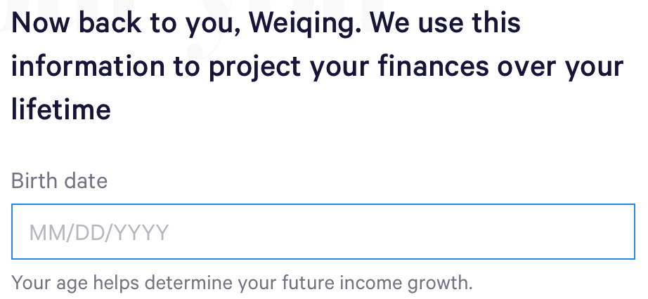

Slide 7
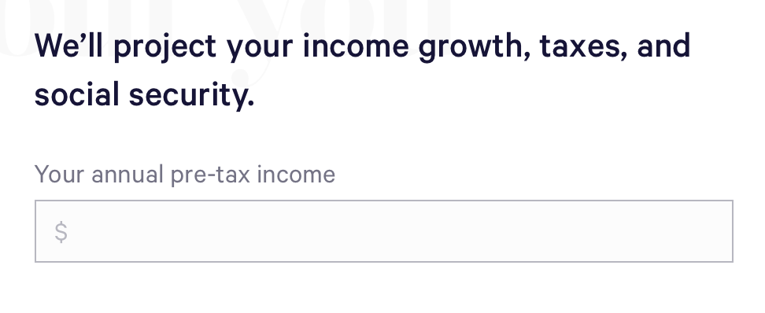

Slide 8
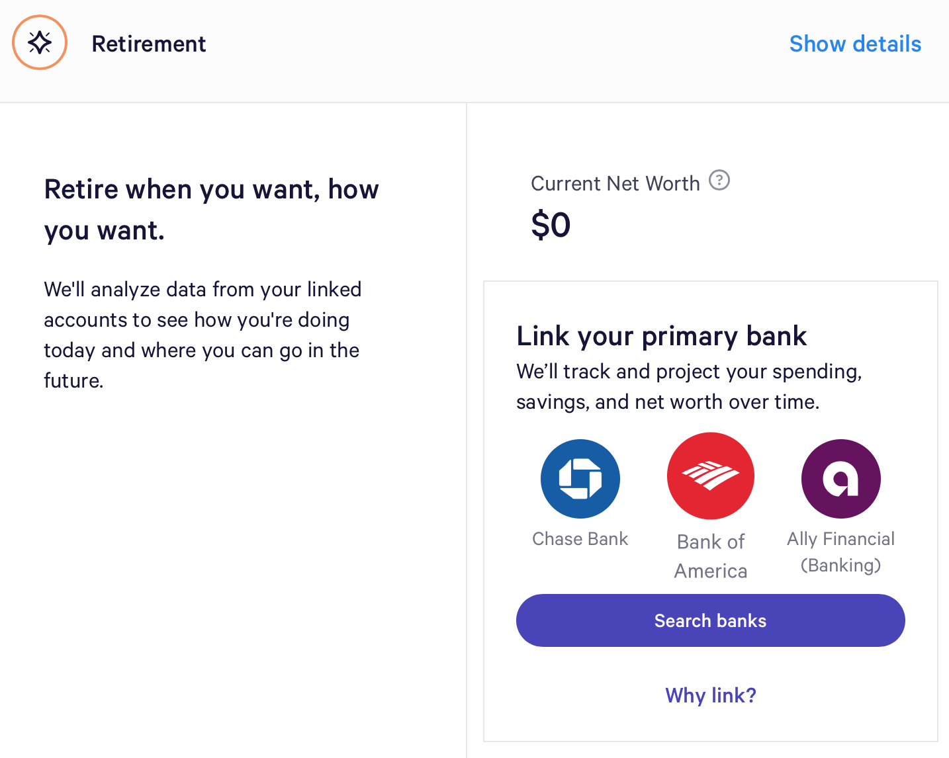

Slide 9
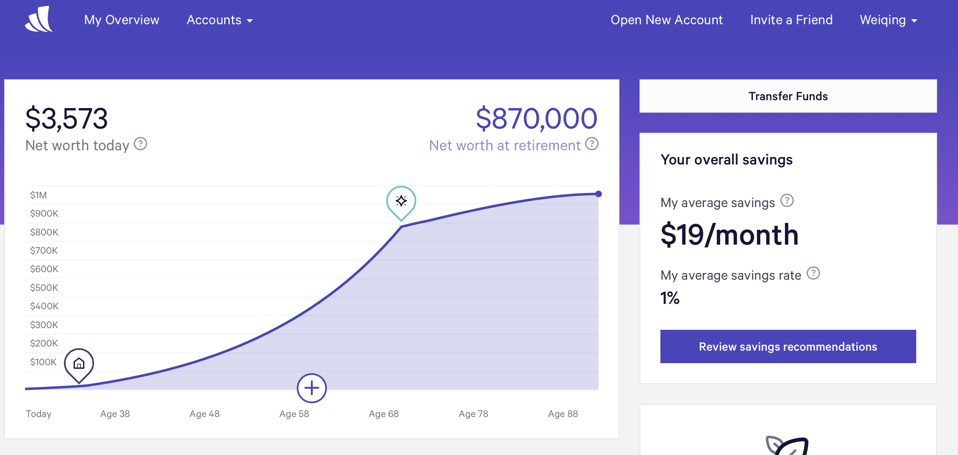

Slide 10
Landscape
Trends and Innovations:
Big finance companies also followed to add robo-advisors to their traditional financial services
Low robo-advisory fee
Hybrid Human-Tech Models
Mobile Capacity

Slide 11
Landscape/Results
Other Robo-Advisor Companies:
Company | Asset Under Management
The Vanguard Group | $83 billion
Charles Schwab Corporation | $33 billion
TD Ameritrade | $20 billion
Betterment | $14 billion
Wealthfront | $11 billion
Personal Capital | $8 billion
FutureAdvisor by BlackRock | $1 billion

Slide 12
Recommendations
Explore more areas of investment
Offering more investment products can achieve potentially higher returns and attract more high-net-worth individuals who can tolerate more risk
Technology needed: algorithmic trading, AI and machine learning

